Slide 1
Crowd Sourcing Water Turbidity Information
Nitay ozer
Itay mal
supervisor adi vainiger

Slide 2


Project Goal
Low-cost, portable and highly available solution for crowdsourcing water turbidity information.
Based of personal smartphone, application and DIY measuring kit.

Slide 3
Motivation
water quality
drinking/agriculture water sources
Environmental effects
Public health
Wildlife research
Sediment transport
Water Based Activities
Water sports
Diving

Slide 4
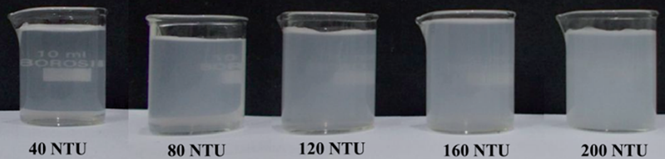
What is turbidity
‘Fogginess’ of a fluid
Commonly measured by NTU or FTU
Image taken from: Hussain, I., Ahamad, K., & Nath, P. (2016). Water turbidity sensing using a smartphone. Rsc Advances, 6(27), 22374-22382.

Slide 5
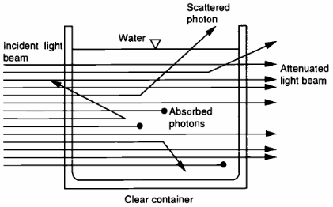
What is turbidity
Intense light scattering caused mainly by fine-particle sediment
Image: Davies-Colley, R.J. and Smith, D.G. (2001), TURBIDITY SUSPENDED SEDIMENT, AND WATER CLARITY: A REVIEW. JAWRA Journal of the American Water Resources Association, 37: 1085-1101.

Slide 6
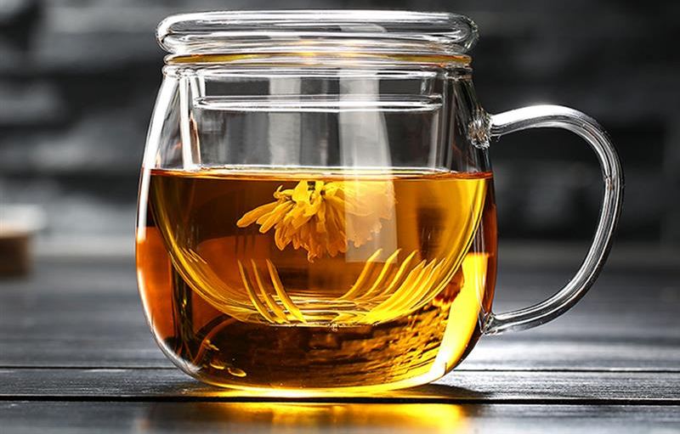
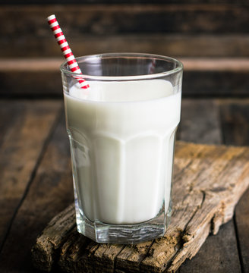
Absorption and Scattering
Tea has high absorption coefficient
Milk has high scattering coefficient

Slide 7
Existing Solutions

Slide 8

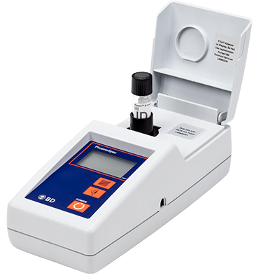



Nephelometer

Slide 9
Nephelometer
The standard
Range of sizes
Based on light scattering
Advantages:
Most accurate
Disadvantages:
$$$

Slide 10
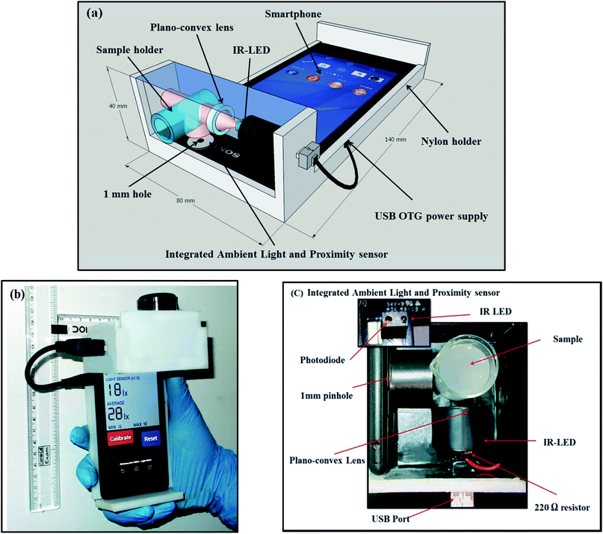
Water turbidity sensing using a smartphone and attached device
Hussain, I., Ahamad, K., & Nath, P. (2016). Water turbidity sensing using a smartphone. Rsc Advances, 6(27), 22374-22382.

Slide 11
Water turbidity sensing using a smartphone and attached device
Application + special device
Uses devices sensors and smartphone computing resources
Based on light scattering
Advantages:
Highly portable
High accuracy
Disadvantages:
Availability
$$

Slide 12
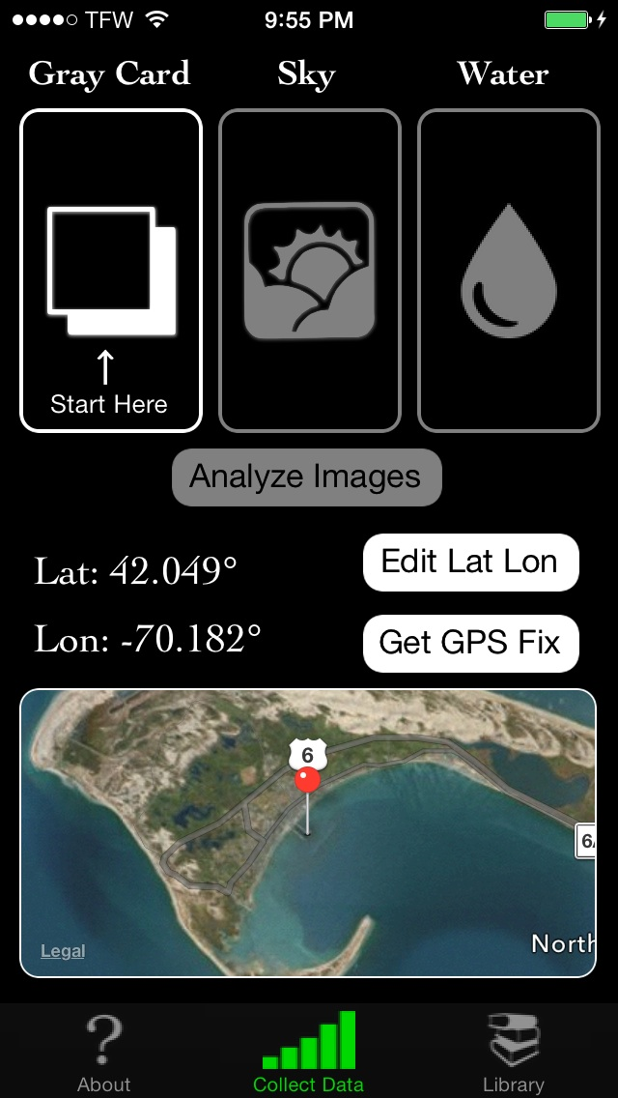
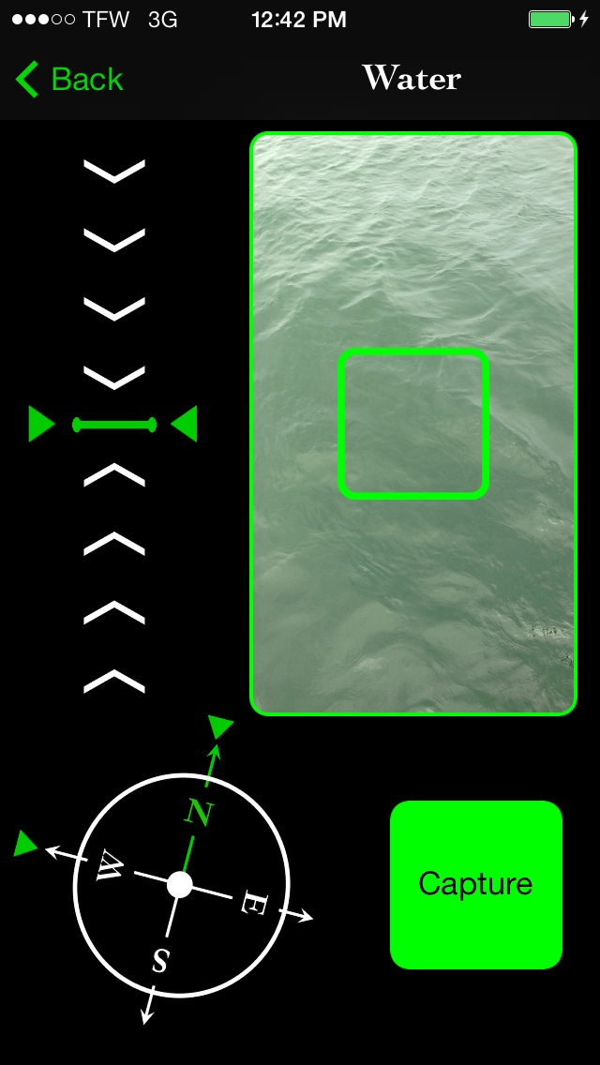
‘HydroColor: Water Quality App’

Slide 13
‘HydroColor: Water Quality App’
Android smartphone application
Uses the smartphone's digital camera
Based on the reflectance of the water
Advantages:
Highly portable
Disadvantages:
Accuracy
$
calibration

Slide 14
Possible Approaches

Slide 15
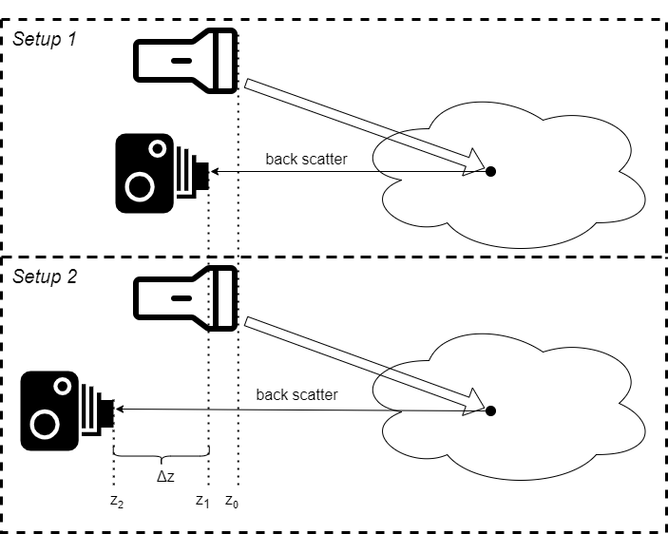
Beam Attenuation
Light source is fixed
Camera moved horizontally
Measuring difference in backscattered light
Main Disadvantage:
Requires external light to be negligible
Requires “clean” scene
$$i_{2}=exp\left(−β⋅Δz\right)⋅i_{1}$$

Slide 16
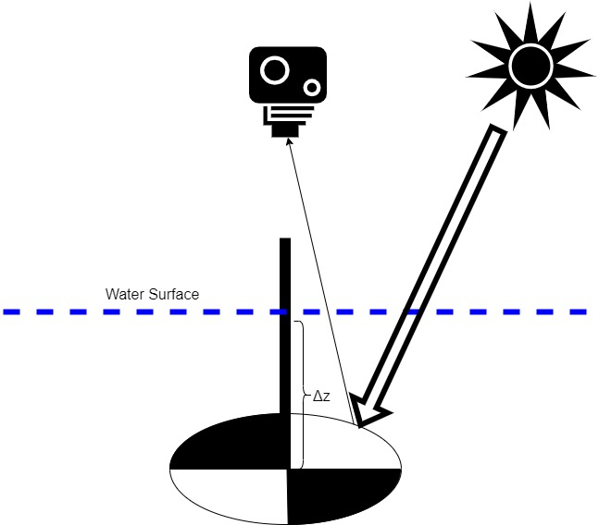

Secchi Disk
Disk is lowered vertically
Measures by disappearance depth
Main disadvantage:
Requires very deep water body
$$β=\frac{\ln\left(\frac{i_{p}^{\left(0\right)}}{i_{p}−i_{p}^{ambient}}\right)}{Δz}$$

Slide 17
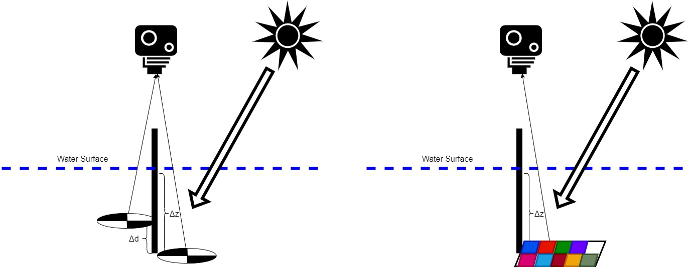
Secchi Disk Improvements
Two targets – reduce required depth
Use color table target – specific wavelength

Slide 18
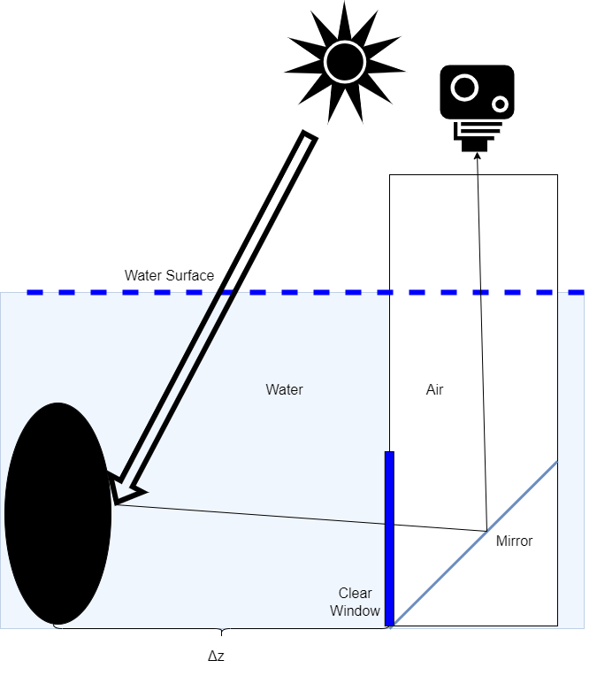

Black Disk
Move the disk horizontally
Based on the disappearance distance
Main disadvantage:
Requires very wide water body
Additional complexity due to viewing apparatus
$$β=\frac{\ln\left(−\frac{1}{C_{T}}\right)}{Δz}$$

Slide 19
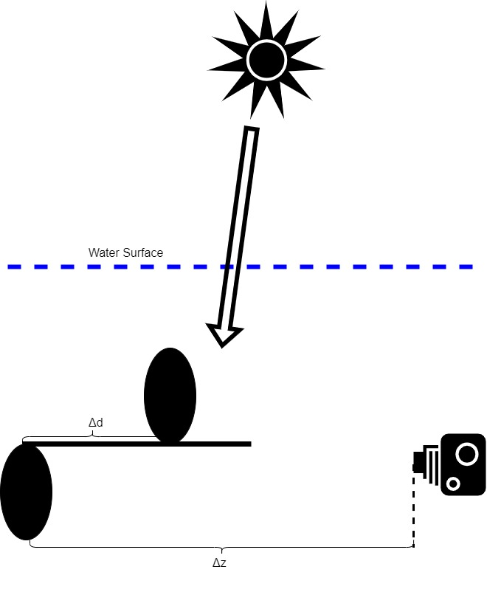
Black Disk Improvements
Take photo underwater – reduce complexity and reflection effect
Two targets – reduce required distance

Slide 20
Purposed Solution

Slide 21
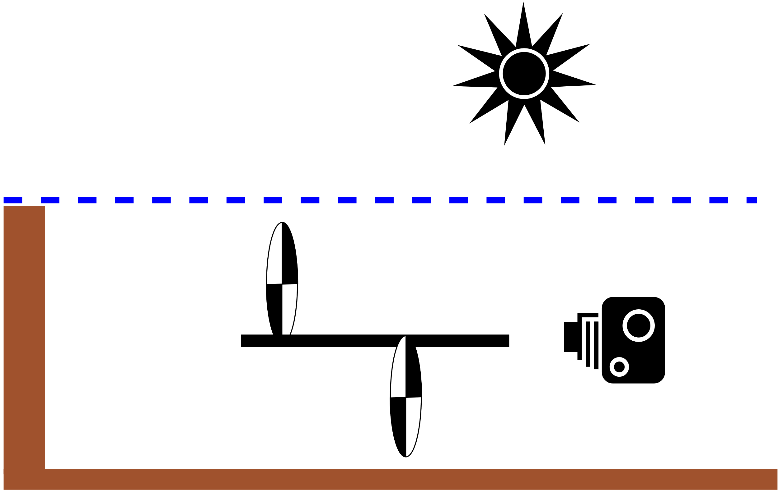
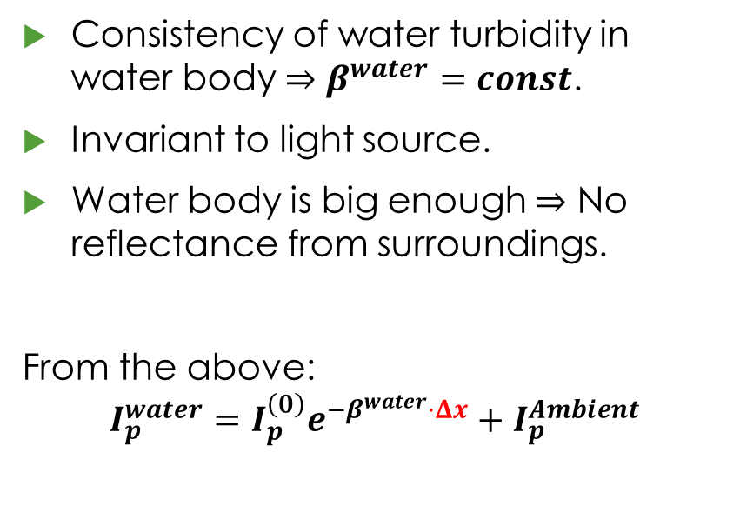
Basic Assumptions
Consistency of water turbidity in water body $⇒β^{water}=const$.
Invariant to light source.
Water body is big enough $⇒$ No reflectance from surroundings.
From the above:
$$I_{p}^{water}=I_{p}^{\left(0\right)}e^{−β^{water}⋅Δx}+I_{p}^{Ambient}$$

Slide 22

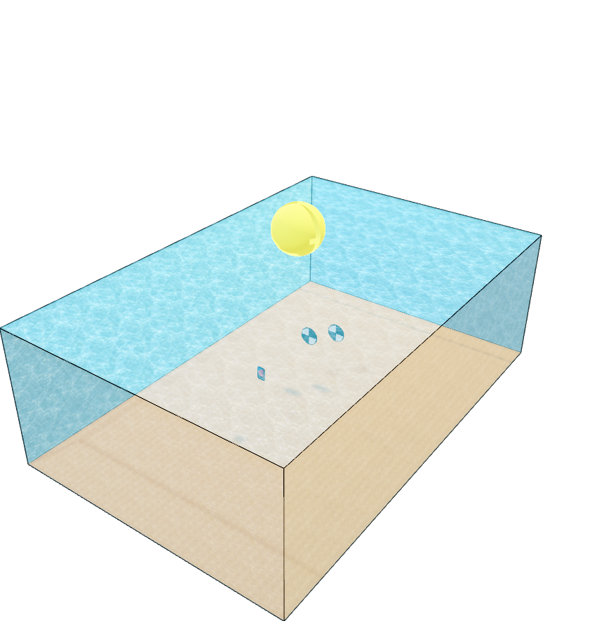
Measurement Setup

Slide 23
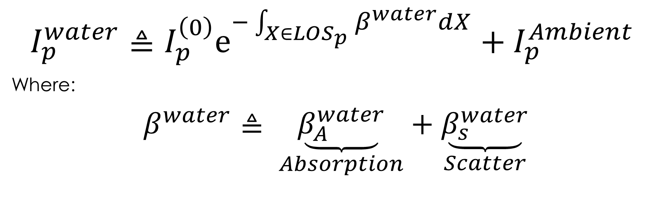
Physical Model - Beer-Lambert Law
$$I_{p}^{water}≜I_{p}^{\left(0\right)}e^{−\int_{X∈LOS_{p}}{β^{water}dX}}+I_{p}^{Ambient}$$
Where:
$β^{water}≜$ $\underset{Absorption}{\underbrace{β_{A}^{water}}}+\underset{Scatter}{\underbrace{β_{s}^{water}}}$

Slide 24

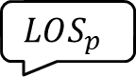
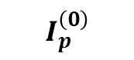
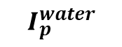
Physical Model
Natural light
$$β^{water}$$
$$I_{p}^{\left(0\right)}$$
$$LOS_{p}$$
$$I_{p}^{water}$$

Slide 25
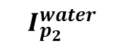
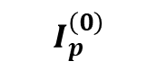
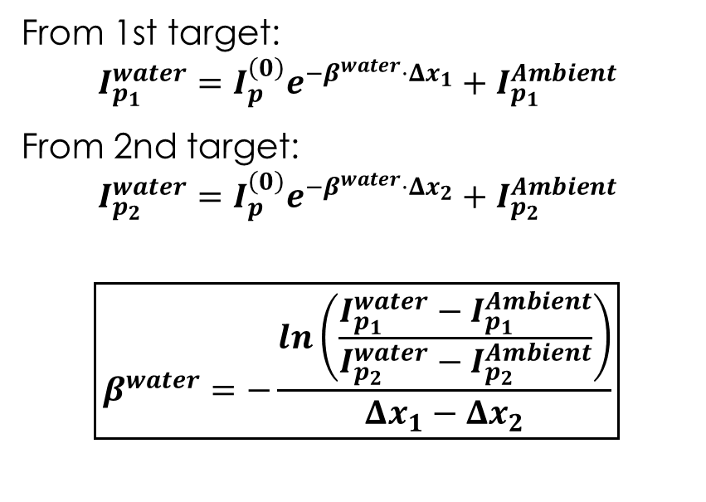
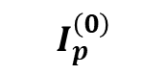
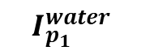


Physical Model
From 1st target:
$$I_{p_{1}}^{water}=I_{p}^{\left(0\right)}e^{−β^{water}⋅Δx_{1}}+I_{p_{1}}^{Ambient}$$
From 2nd target:
$$I_{p_{2}}^{water}=I_{p}^{\left(0\right)}e^{−β^{water}⋅Δx_{2}}+I_{p_{2}}^{Ambient}$$
$$\boxed{β^{water}=−\frac{ln\left(\frac{I_{p_{1}}^{water}−I_{p_{1}}^{Ambient}}{I_{p_{2}}^{water}−I_{p_{2}}^{Ambient}}\right)}{Δx_{1}−Δx_{2}}}$$
$$I_{p}^{\left(0\right)}$$
$$Δx_{1}$$
$$I_{p_{1}}^{water}$$
$$I_{p}^{\left(0\right)}$$
$$I_{p_{2}}^{water}$$
$$Δx_{2}$$

Slide 26
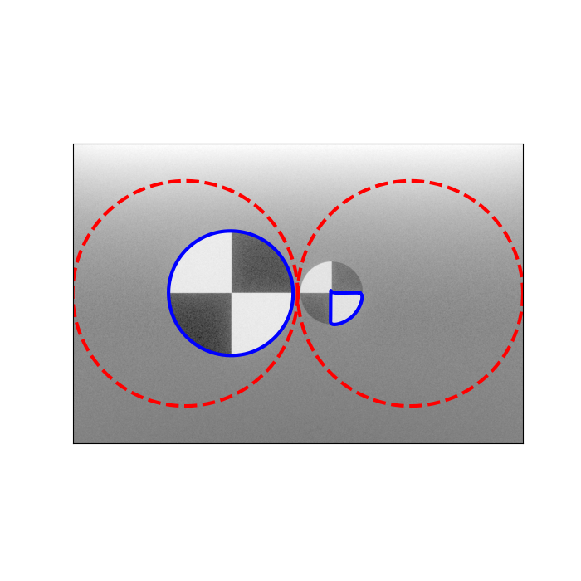
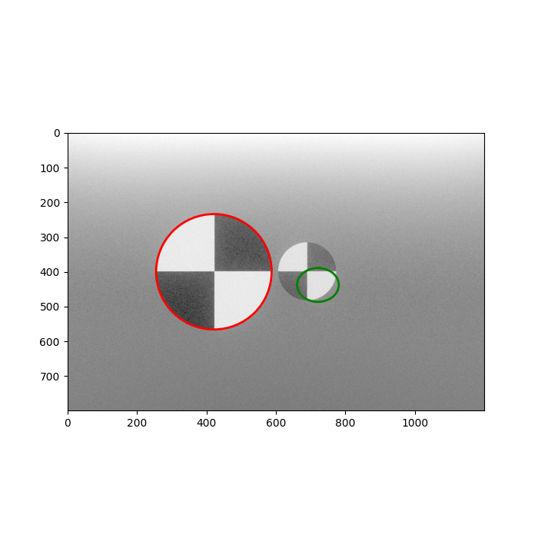
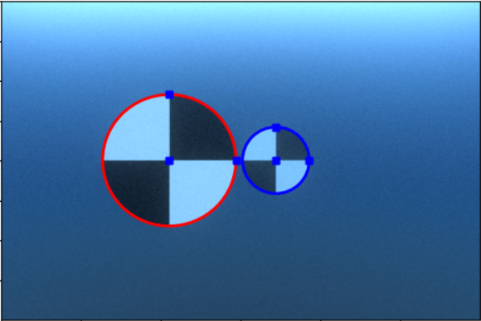
Algorithm Description – Target Detection
1
2
3
Active Contours
Ellipse RANSAC
User Correction

Slide 27
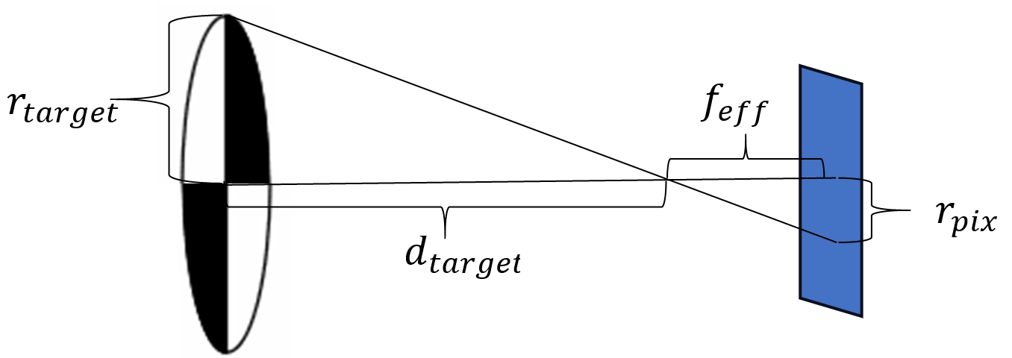
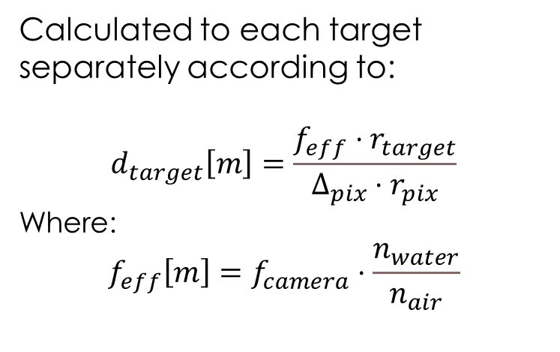
Algorithm Description – Target Distance Calculation
Calculated to each target separately according to:
$$d_{target}\left[m\right]=\frac{f_{eff}⋅r_{target}}{Δ_{pix}⋅r_{pix}}$$
Where:
$$f_{eff}\left[m\right]=f_{camera}⋅\frac{n_{water}}{n_{air}}$$

Slide 28

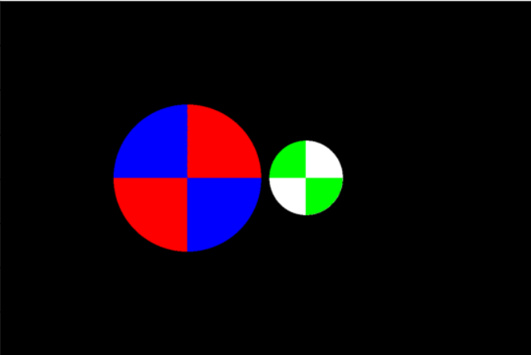
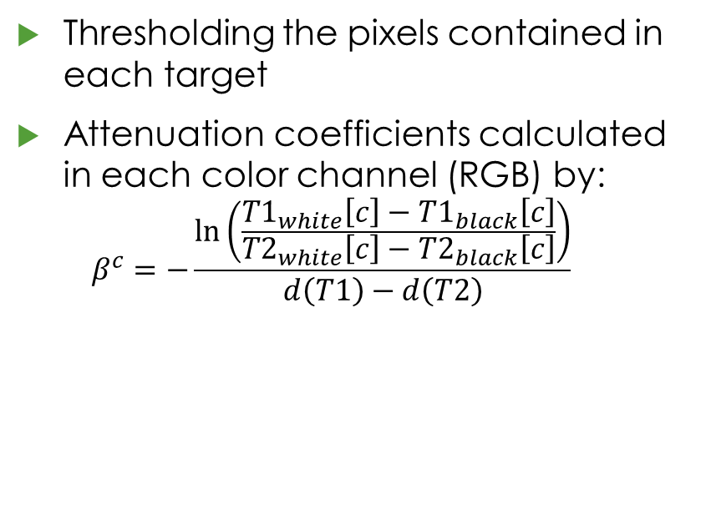
Algorithm Description – Targets Segmenting and Final Calculation
Thresholding the pixels contained in each target
Attenuation coefficients calculated in each color channel (RGB) by: $β^{c}=−\frac{\ln\left(\frac{T1_{white}\left[c\right]−T1_{black}\left[c\right]}{T2_{white}\left[c\right]−T2_{black}\left[c\right]}\right)}{d\left(T1\right)−d\left(T2\right)}$

Slide 29
Results

Slide 30
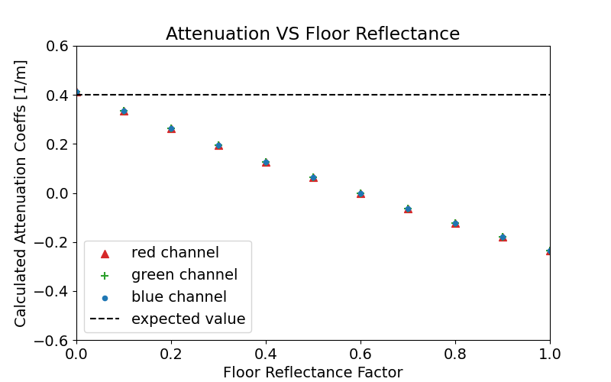

Assumptions Validation
Environment Reflections

Slide 31
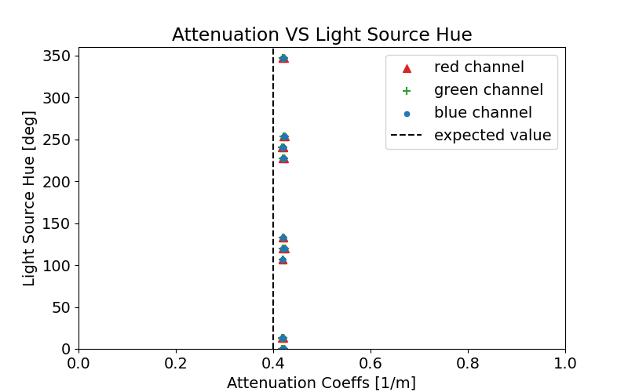
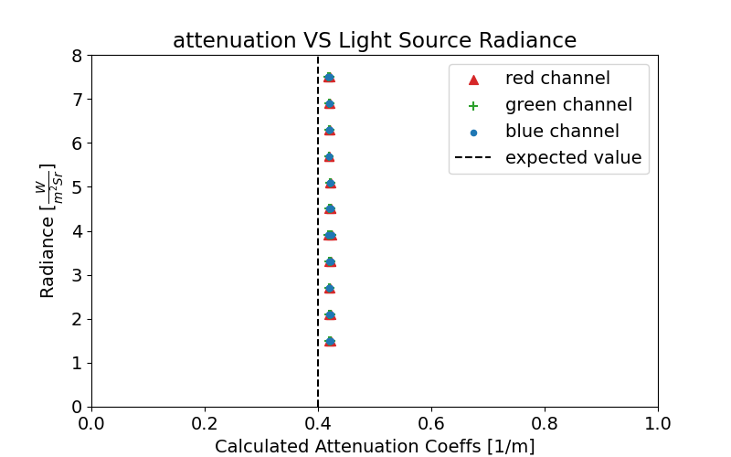
Assumptions Validation
Light Hue and Radiance

Slide 32
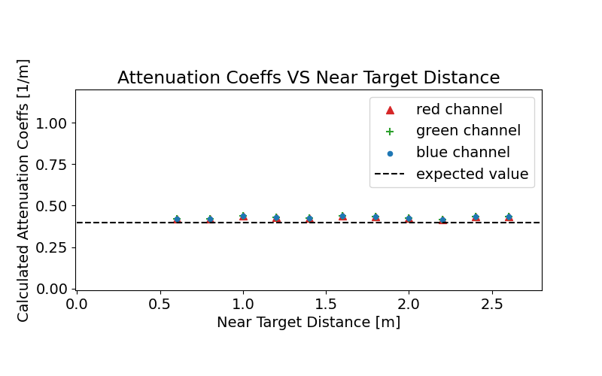
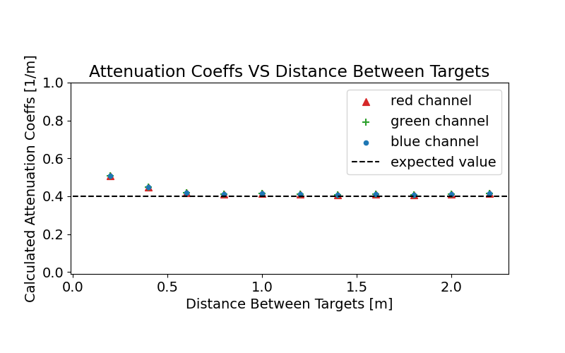
Assumptions Validation
Targets Distances

Slide 33
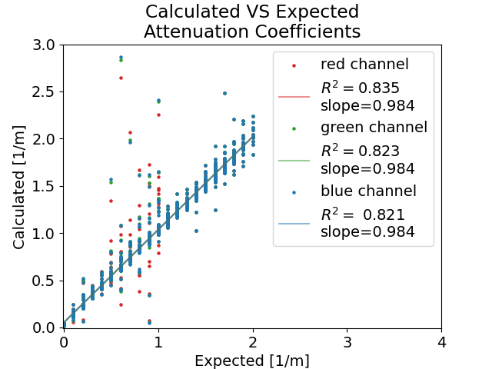
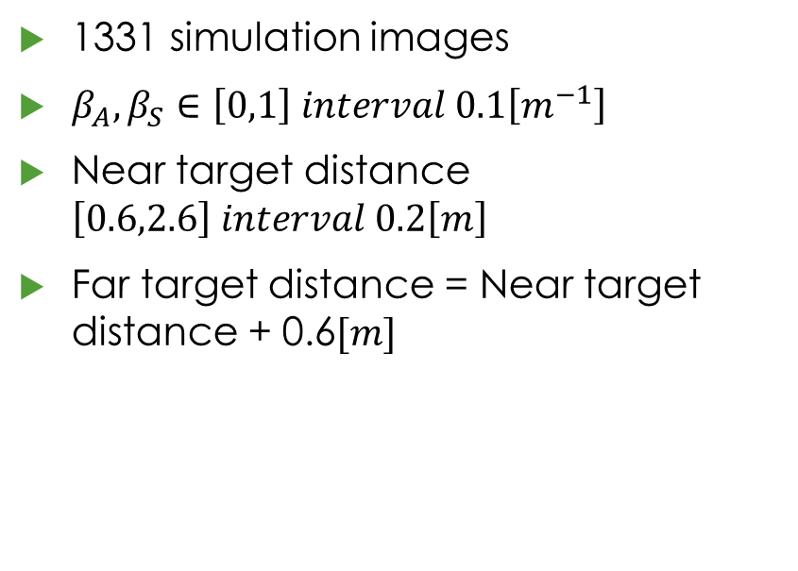
Large Scale Testing
1331 simulation images
$β_{A},β_{S}∈\left[0,1\right] interval 0.1\left[m^{−1}\right]$
Near target distance $\left[0.6,2.6\right] interval 0.2\left[m\right]$
Far target distance = Near target distance + 0.6$[m]$

Slide 34
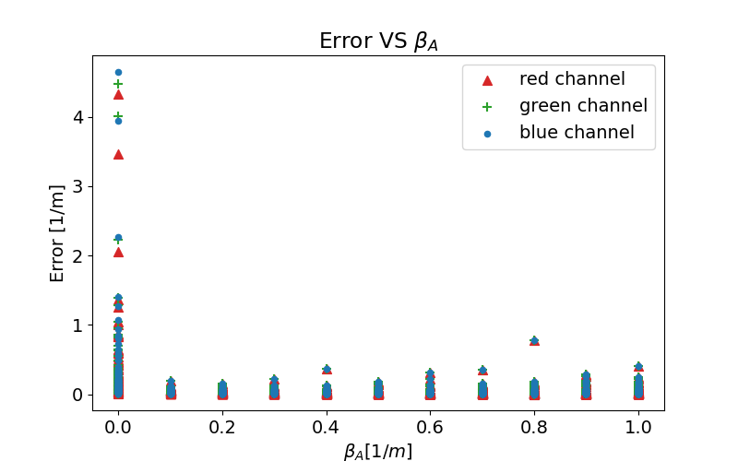
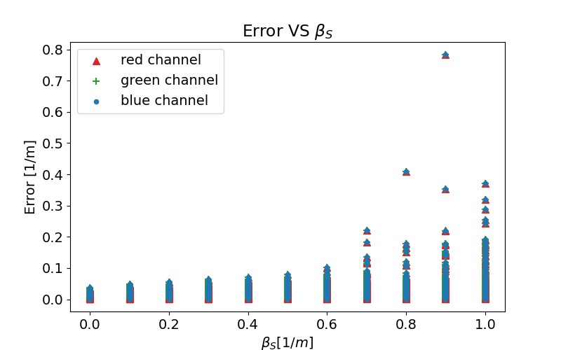
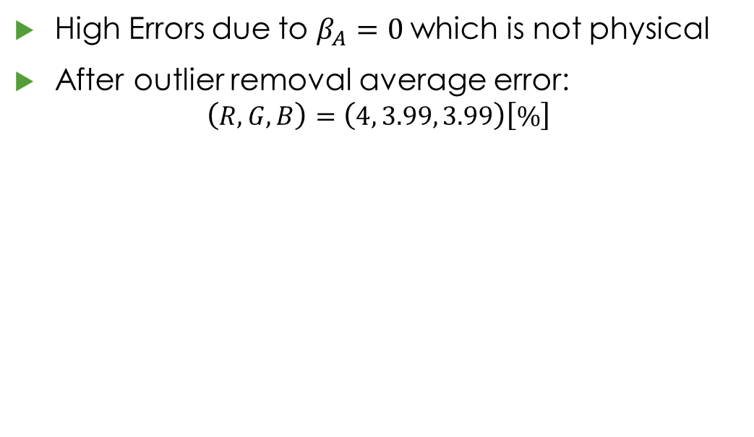
Large Scale Testing – Error Analysis
High Errors due to $β_{A}=0$ which is not physical
After outlier removal average error: $\left(R,G,B\right)=\left(4, 3.99, 3.99\right)\left[\%\right]$

Slide 35


Large Scale Testing – Error Analysis
Other possible error factors:
Target localization error
Mutual interference between targets (shadowing)
Finite accuracy of pixel values
light source
shadow
target 2
target 1

Slide 36
Application Demo

Slide 37
Challenges

Slide 38
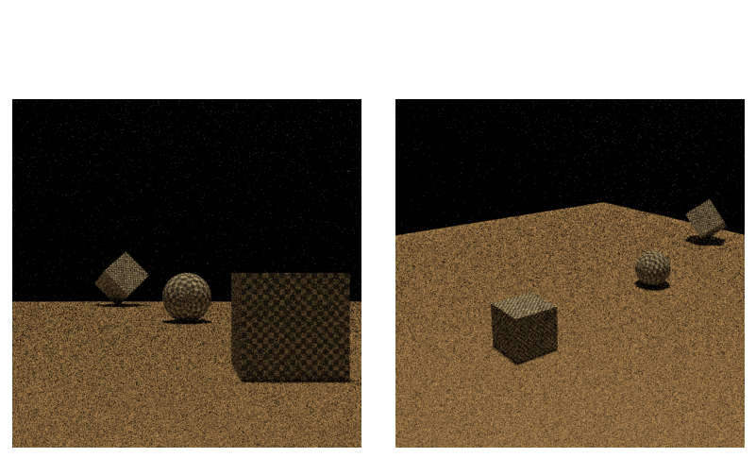
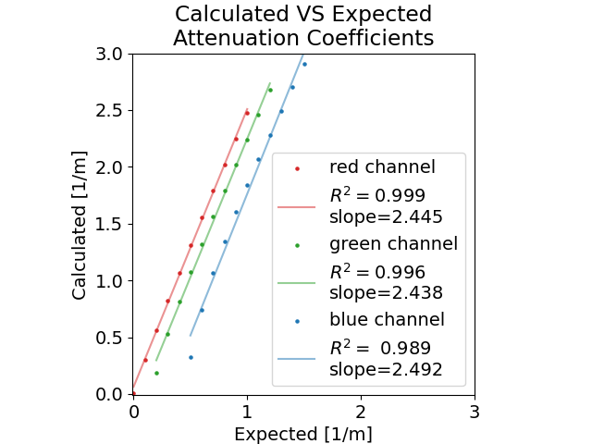
Simulating Realistic Scene
Mitsuba 3 Readiness
Mitsuba 0.5 Properties Definition

Slide 39
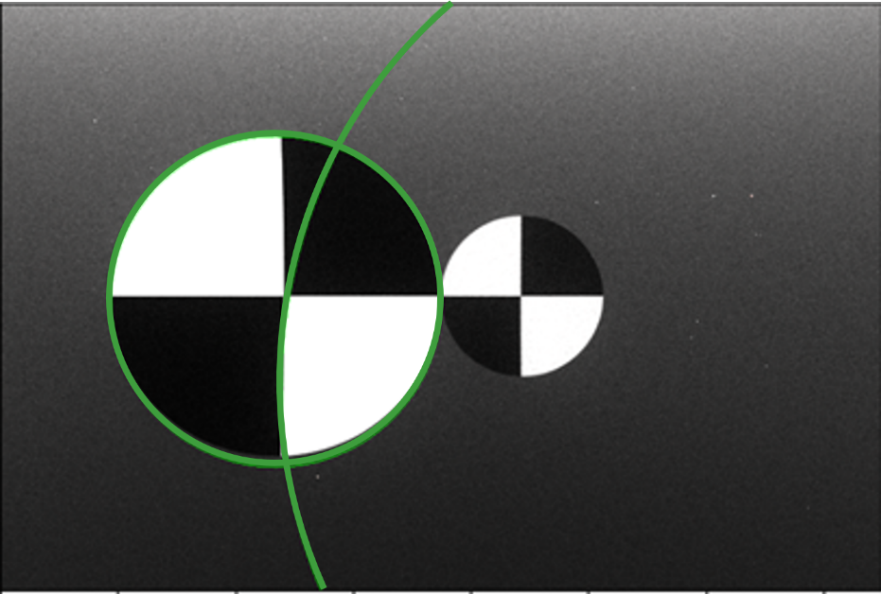
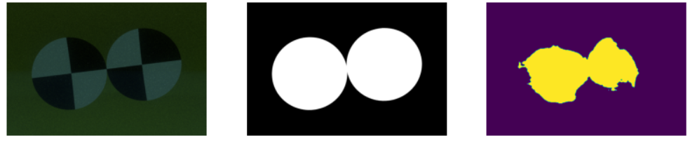
Target Detection Methods
Classical Approach (Hough)
Critical stage to the algorithm success
We have tried many approaches and variants
Chosen solution must be robust
Deep Learn Methods (DeepLab)

Slide 40
Conclusions

Slide 41
Conclusions
In this project we developed an affordable method for remote sensing of water attenuation properties that suits crowdsourcing.
The method has been proven as stable and accurate with physically based simulation products with ~4% error.
This project involves wide range of fields: computer vision and graphics, Image processing, ML, optics etc. we have learned a lot and gained valuable practical experience.
We hope that this project will be beneficial for future works and applications to come.

Slide 42
Conclusions
Due to mentioned challenges, we failed reach some of our initial goals:
Testing on real life images
Converting attenuation coefficients to NTU/FTU
Mobile device application development
Web based database for result sharing

Slide 43
Further Work Suggestions
Using color targets to isolate wavelength bands – profile contaminators.
Isolate scatter coefficient by measuring diffusion of pattern in targets.
Improving specific parts of our algorithm e.g. better automatic target detection.

